Slide 1


GRAPH AND ITS REPRESENTATION
- SARAHANA SUWAL

Slide 2


GRAPH
Graph is the set of edges that connect those nodes to each other .
We can say it is pictorial representation of finite set of objects connected by finite set of links.
It is a non linear data structure,
Example in real life:
Highway
Social network
Maps
Computer network

Slide 3

GRAPH

Slide 4
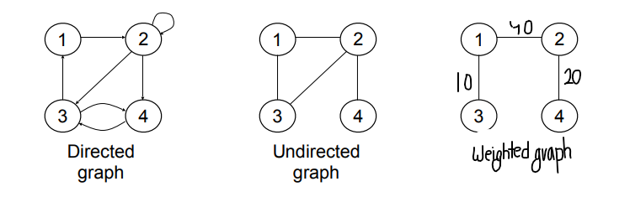
TYPES OF GRAPH
DIRECTED GRAPH
UNDIRECTED GRAPH
WEIGHTED GRAPH

Slide 5
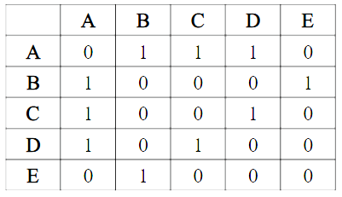
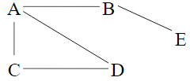
Adjacent matrix
Graph with n vertices gives n X n adjacency matrix
If vertex i is adjacent to vertex j then, A[i][j]= 1 otherwise 0 is written

Slide 6
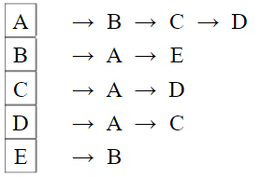
Adjacency list
If vertex i is adjacent to vertex j then
J is in the adjacency list for i
And i is in the adjacency list for j

Slide 7
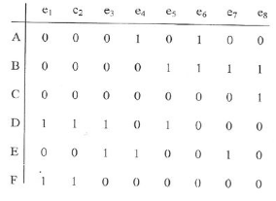
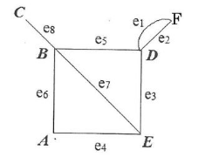
Incident matrix
In A ij if jth edge is incident on the ith vertex vi then 1 is written otherwise its 0.
Graph shouldn’t contain self loops

Slide 8
THANK YOU!

